Slide 1


VISVESVARAYA TECHNOLOGICAL UNIVERSITY
Presentation on
Project Phase-2
AI DRIVEN AGRICULTURAL LAND ADAPTION SYSTEM
Submitted by
Narendra M 4BB22IS023
Prajwal D Naik 4BB22IS029
Range Gowda KM 4BB23IS401
Under the Guidance of
Dr. Yashodha M, B.E., M. Tech., Ph.D.
Professor & HOD
Department of Information Science and Engineering
DEPARTMENT OF INFORMATION SCIENCE AND ENGINEERING
Bahubali College of Engineering
Shravanabelagola – 573 135
2025-26

Slide 2
CONTENTS
  AIM
SCOPE
OBJECTIVES
LITERATURE SURVEY
Draw Backs of Existing Application
Advantages of Proposed Application
Functionalities and Non Functionalities
METHODOLOGY
HARDWARE AND SOFTWARE REQUIREMENTS
Coding
RESULT EXPECTED
Conclusion
ReferenceS

Slide 3
AIM:
To develop an AI-driven system that intelligently monitors, analyzes, and adapts agricultural land use based on changing environmental and soil properties, in order to enhance crop productivity, sustainability, and resilience to climate change.

Slide 4
SCOPE:
It will check the land, weather, and ownership changes for crop planning, irrigation strategies, and sustainable land management practices.
It will give advice on the best crops to grow and how to take care of the land.
It will help farmers, government workers, and organizations make smart decisions.
It will not handle land fights or replace real experts, but it will help them.

Slide 5
Design the system to be scalable across different regions with localized adaptation based on specific climatic and land conditions.
OBJECTIVES:
To collect real-time information about soil, weather and land system.
To use artificial intelligence (AI) to study this information and find patterns or changes that affect farming.
To give helpful suggestions to farmers on what crops to grow, how to use water, and how to care for the land based on current conditions.
Combine data from climate models, and local observations for comprehensive land use analysis.
Design the system to be scalable across different regions with localized adaptation based on specific climatic and land conditions.

Slide 6

Crop Recommendation Using ML
Authors:
Patil et al.
Year:
2020
Summary:
Used Support Vector Machines (SVM) to develop a system that recommends crops based on soil and climatic conditions. Showed good accuracy in yield prediction and land suitability classification.

Slide 7

Climate-Resilient Cropping
Authors:
Karthikeyan et al.
Year:
2022
Used deep learning models (CNNs and LSTMs) to predict monsoon variability. Recommended adaptive cropping patterns to mitigate climate change risks.

Slide 8
AI-Driven Crop Recommendation System for Agriculture 4.0
Authors:
Ibrahim Kok
Year:
(2024)
This study introduces AgroXAI, an edge computing-based explainable AI system that recommends suitable crops based on local weather and soil conditions. It emphasizes model transparency through techniques like SHAP and LIME, enhancing trust among farmers and promoting regional crop diversification.

Slide 9


Transfer Learning in Agriculture
Md Ismail Hossen
Year:
(2025)
This comprehensive review discusses the application of transfer learning in agriculture, highlighting its potential to improve model performance across different regions with limited labeled data.

Slide 10
Integration of IoT-AI Powered Local Weather Forecasting
Authors:
Suman Kumar Das
Year:
(2024)
The authors propose a framework combining IoT and AI for localized weather forecasting. This integration aims to provide real-time, high-resolution meteorological data, supporting informed decision-making in agriculture and improving overall farm productivity and sustainability.

Slide 11
Smart Farming Using Artificial Intelligence
Authors:
Aruna Varanasi
Year:
(2023)
Summary:
The authors review the applications of AI in smart farming, focusing on areas such as weed and crop discrimination using image analysis. They highlight how AI technologies contribute to precision agriculture and sustainable farming practices.

Slide 12
A Systematic Review of the Use of Deep Learning in Satellite Imagery for Agriculture
Authors:
Brandon Victor
Year:
(2024)
Summary:
This systematic review analyzes 150 studies on deep learning applications in satellite imagery for agriculture. It identifies key tasks such as crop segmentation and yield prediction, highlighting the advantages of deep learning over traditional machine learning methods in these areas.

Slide 13
Automated Pest Detection with DNN on the Edge for Precision Agriculture
Authors:
Andrea Albanese
Year:
(2021)
Summary:
This study presents an embedded system enhanced with deep neural networks (DNN) for continuous pest detection in fruit orchards. The system utilizes low-power sensing devices and energy harvesting functionalities, enabling autonomous and long-term monitoring without farmer intervention.

Slide 14
Draw Backs of Existing Application
Agricultural data is often fragmented across different platforms .
Cannot forecast future land changes or dynamically suggest crop rotation and input changes.
Systems are not equipped to model long-term scenarios like temperature rise, rainfall shifts, or extreme weather events.
Weather or climate changes are often recognized too late to mitigate damage.

Slide 15
Advantages of proposed application
Increases crop yield.
Supports sustainable agriculture.
Adapts farming to climate changes.
Reduces fertilizer and pesticide wastage.
Saves water through smart irrigation.
Predicts risks like drought and soil degradation.

Slide 16
Functionalities:
Land Suitability Analysis:
It should collect and analyze data, provide clear recommendations, and alert users about risks.
Climate and Weather Adaptation:
Integrates real-time weather forecasts and climate models to predict changes in rainfall, temperature, and humidity.
Crop Recommendation and Yield Prediction:
Recommends crops best suited for current and future land conditions.
Sustainability and Carbon Management:
Suggests eco-friendly practices like reduced village, organic inputs, and precision farming.
Soil Health Monitoring:
Detects degradation patterns and provides remediation recommendations such as fertilizer application or cover cropping.

Slide 17
Non-Functionalities
Performance – The system should process data quickly and give results in real time.
Scalability – It should work for both small farms and large agricultural areas.
Accuracy – AI predictions and recommendations should be highly reliable.
Usability – The interface should be simple and easy for farmers to use.
Security – All data (soil, weather, user info) must be safe and protected.
Availability – The system should be available 24/7 with minimal downtime.
Maintainability – Easy to update and fix errors without affecting performance.

Slide 18
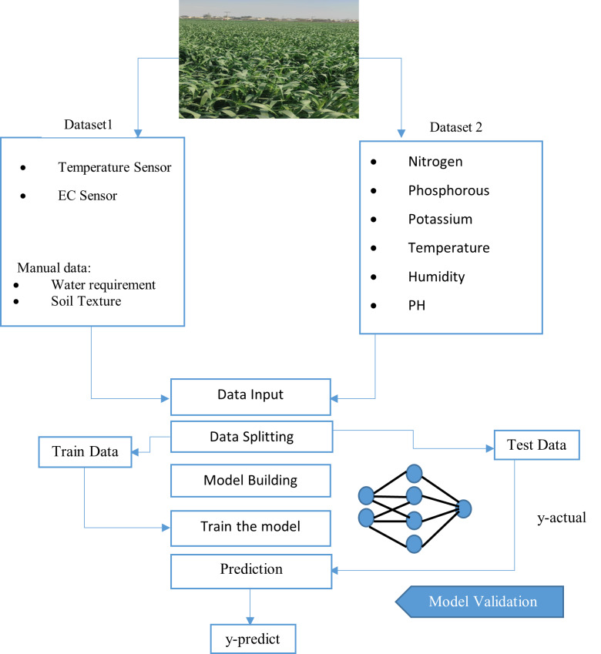
Methodology:

Slide 19
METHODOLOGY:
Use AI to generate adaptive recommendations for crop selection, irrigation planning, and land use adjustments.
The AI will suggest the best crops to grow and how to take care of the land.
The system updates and improves its accuracy using new data over time.
Compare AI-driven strategies with traditional methods to measure improvement in productivity and sustainability.

Slide 20
Hardware and Software Requirements:
Hard Disk: 500 GB or more
RAM: 4 GB or more
Processor: i3 or Above
Front End Language: HTML, CSS, JavaScript
Backend Language: Python 3.8 and JavaScript
Operating System: Window 11

Slide 21
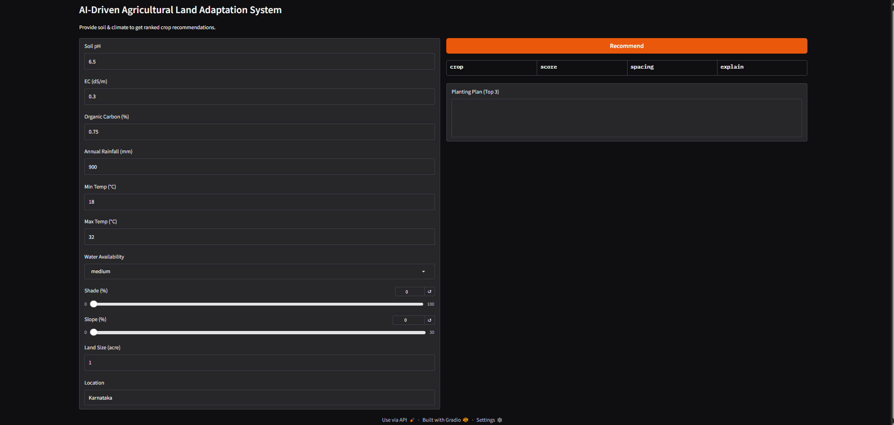
Snapshots:
Classification Result of Crop Prediction Model

Slide 22
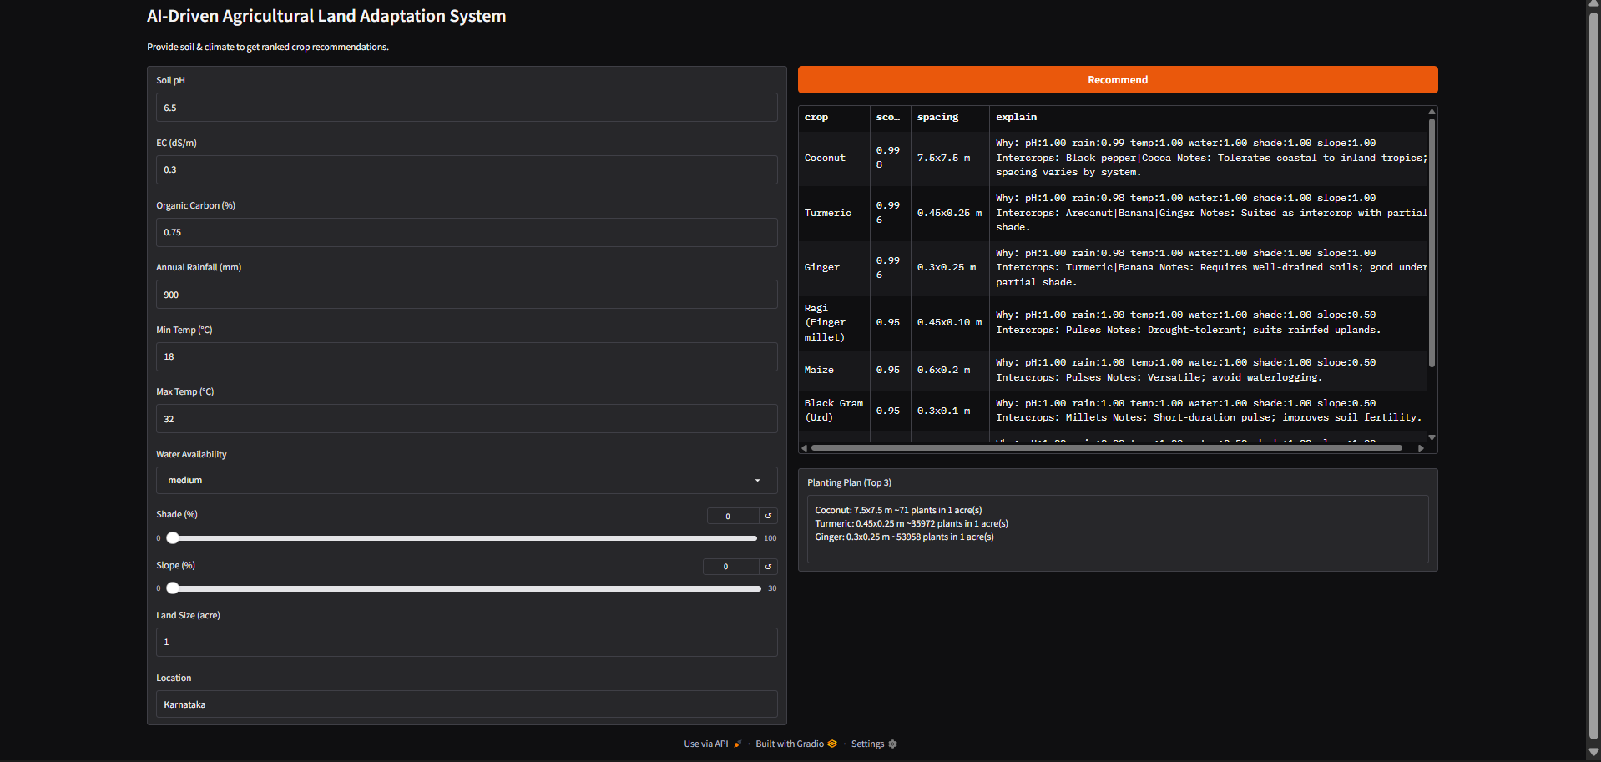
User Input and Recommended Crop Output

Slide 23
RESULT EXPECTED:
The AI-Driven Agricultural Land Adaptation System is expected to significantly improve agricultural productivity by providing farmers with real-time, data- driven insights for better crop selection, irrigation, and soil management.

Slide 24
CONCLUSION
The AI-Driven Agricultural Land Adaptation System has shown that modern technology can play a powerful role in improving farming practices. By using real-time data and artificial intelligence, the system helps farmers make smarter decisions about which crops to grow, how to manage water and fertilizers, and how to deal with changing weather or soil conditions. It provides early warnings about risks like droughts, pests, and diseases, which helps prevent crop loss. The system is easy to use, even for farmers with little technical knowledge, and can be accessed through mobile or web platforms. Overall, this AI- based approach supports more efficient, sustainable, and productive agriculture, making it a useful tool for future farming needs.

Slide 25
REFERENCES
1) Hossen, M. I., et al. (2023). AgroXAI: An Edge Computing-based Explainable
Crop Recommendation System. Turkish Journal of Computer and Mathematics
Education. ..\OneDrive\Desktop\S277323712200020X.htm
2) Introduction to AI-Driven Agricultural land adoption system Accessed
December 2024. https://www.geeksforgeeks.org/ system processing.
3) Effectively Pre-processing the Text Data Part 1: Text Cleaning Accessed
December 2024. https://towardsdatascience.com/ effectively-pre-processingthe-
text-data-part- 1text-cleaning.
4) “Exploring Collaborative Filtering on Implicit Data for Job Recommendations”.
5) Karthikeyan, K., & Kowsalya, R. (2023). Artificial Intelligence Applications in
Agriculture. International Journal of Advanced Research in Computer and
Communication Engineering.

Slide 26
THANK YOU

